Slide 1
Biological Modeling of Neural Networks
Week 4 – part 2: More Detail – compartmental models
4.2. Adding detail
- synapse
-cable equation
Week 4
– Reducing detail
- Adding detail
Wulfram Gerstner
EPFL, Lausanne, Switzerland
Notes:
原来的内容忽略了两个问题
1，神经元的空间结构，原来的把他们当成了一个点。
2，电流的来源，原来的电流是从外面input进去的，平时基本不存在这样的情况。

Slide 2
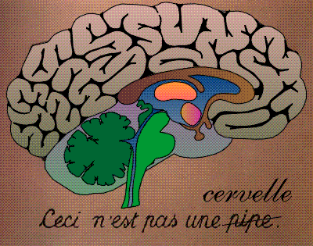
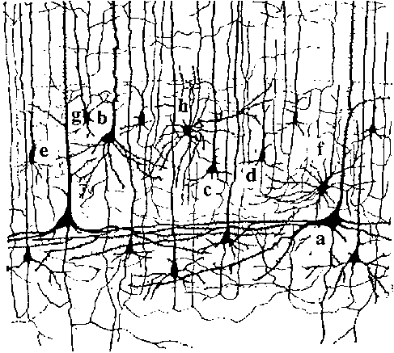
Neuronal Dynamics – 4.2. Neurons and Synapses
motor
cortex
frontal
cortex
to motor
output

Slide 3
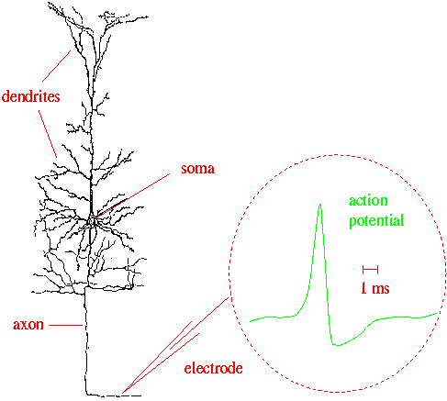
Neuronal Dynamics – 4.2 Neurons and Synapses
What happens
in a dendrite?
What happens
at a synapse?
action
potential
synapse
Ramon y Cajal

Slide 4
Neuronal Dynamics – 4.2. Synapses
Synapse

Slide 5
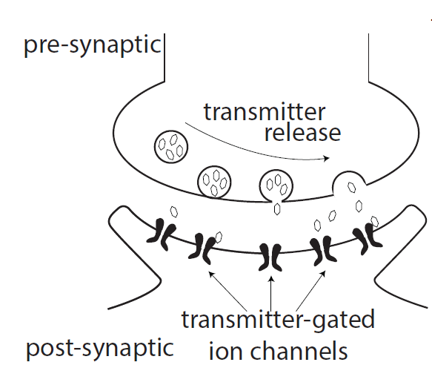
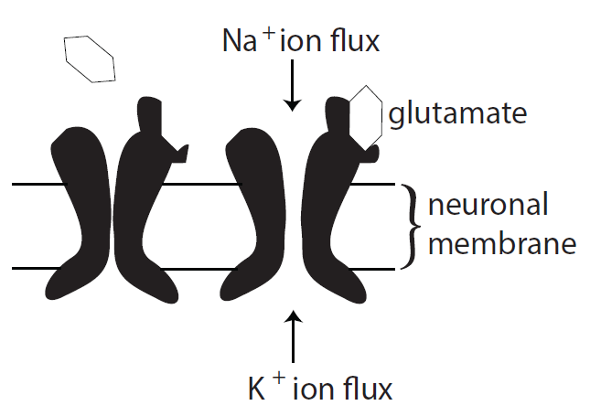
Neuronal Dynamics – 4.2 Synapses
glutamate: Important neurotransmitter at excitatory synapses
image: Neuronal Dynamics,
Cambridge Univ. Press
Notes:
One of the excitatory channels is the so-called AMPA channel. If it opens, it makes a thin channel wide enough for sodium and potassium to pass through, but not wide enough for calcium.

Slide 6
Neuronal Dynamics – 4.2. Synapses
glutamate: Important neurotransmitter at excitatory synapses
AMPA channel: rapid, calcium cannot pass if open
NMDA channel: slow, calcium can pass, if open
(N-methyl-D-aspartate)
GABA: Important neurotransmitter at inhibitory synapses
(gamma-aminobutyric acid)
Channel subtypes GABA-A and GABA-B

Slide 7
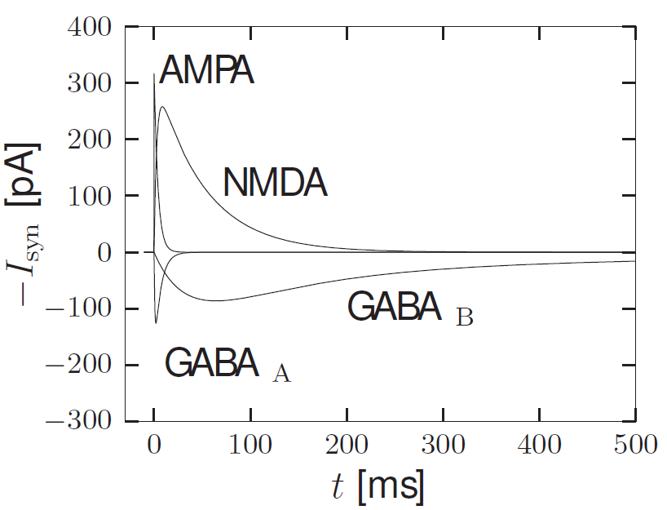
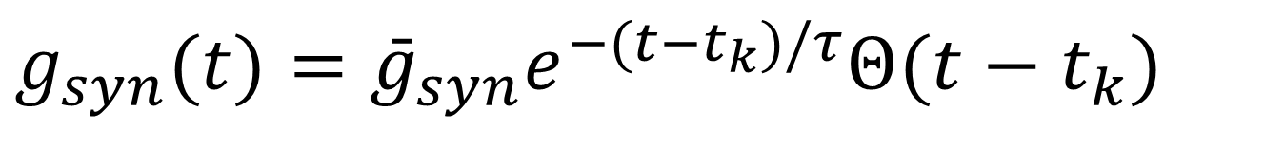
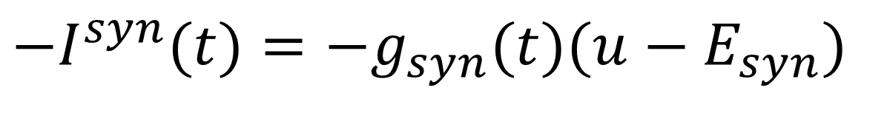
Neuronal Dynamics – 4.2. Synapse types
Model?
$$g_{syn}(t)={\bar{g}}_{syn}e^{−(t−t_{k})/τ}Θ(t−t_{k})$$
$$−I^{syn}(t)=−g_{syn}(t)(u−E_{syn})$$
image: Neuronal Dynamics,
Cambridge Univ. Press

Slide 8
Neuronal Dynamics – 4.2. Synapse model
Model?
$$g_{syn}(t)={\bar{g}}_{syn}e^{−(t−t_{k})/τ}Θ(t−t_{k})$$
$$−I^{syn}(t)=−g_{syn}(t)(u−E_{syn})$$
image: Neuronal Dynamics,
Cambridge Univ. Press

Slide 9
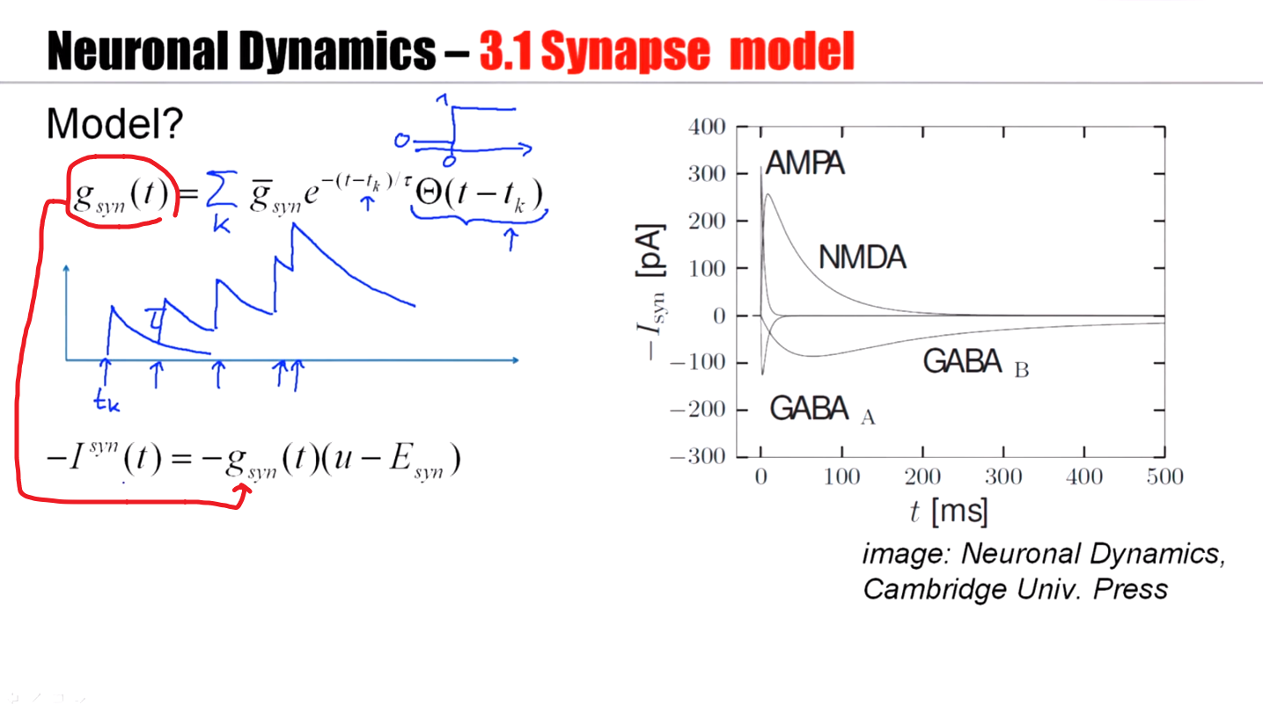

Slide 10
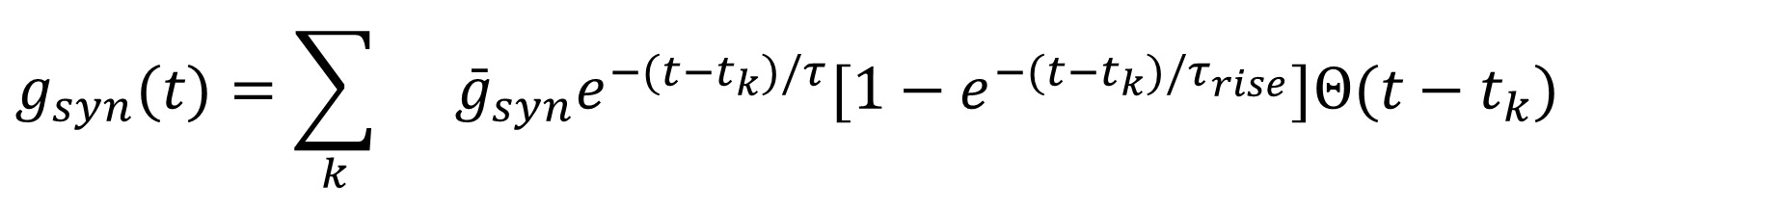
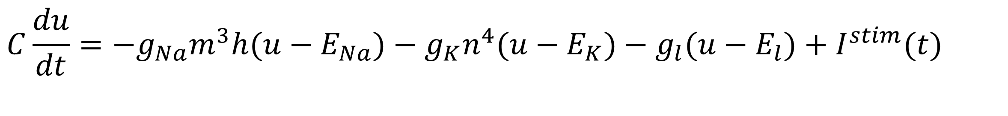
Neuronal Dynamics – 4.2. Synapse model
Model with rise time
$$g_{syn}(t)=\sum_{k}{}{\bar{g}}_{syn}e^{−(t−t_{k})/τ}[1−e^{−(t−t_{k})/τ_{rise}}]Θ(t−t_{k})$$
$$−I^{syn}(t)=−g_{syn}(t)(u−E_{syn})$$
$$C\frac{du}{dt}=−g_{Na}m^{3}h(u−E_{Na})−g_{K}n^{4}(u−E_{K})−g_{l}(u−E_{l})+I^{stim}(t)$$
image: Neuronal Dynamics,
Cambridge Univ. Press
Notes:
A slightly more complicated model: not just with decay time, but there's also a rise time.

Slide 11
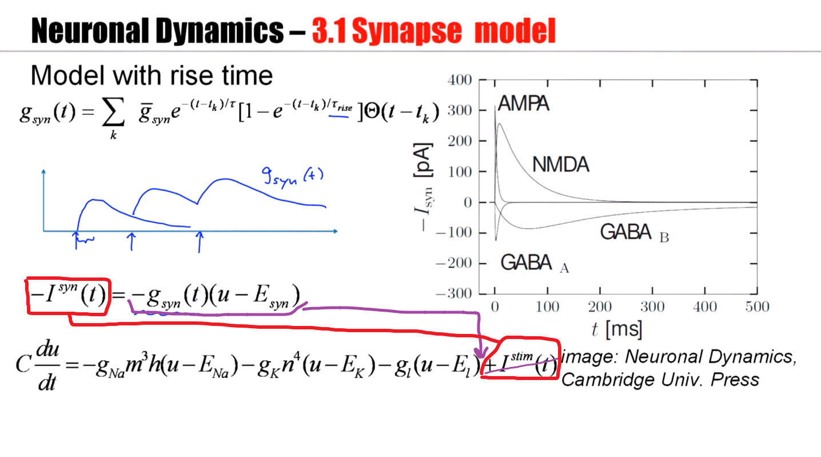
Notes:
有两种解释：
1，突触的电流就是“外部”的刺激电流；
2，在真实的神经元中，是没有“刺激电流”的，只有离子通道。以突触的离子通道替代刺激电流。

Slide 12
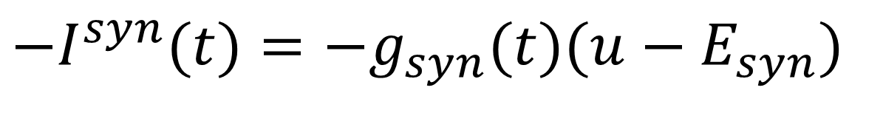
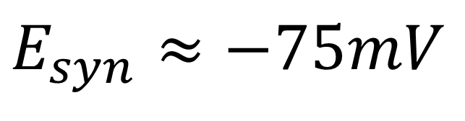
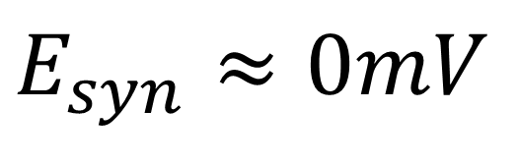
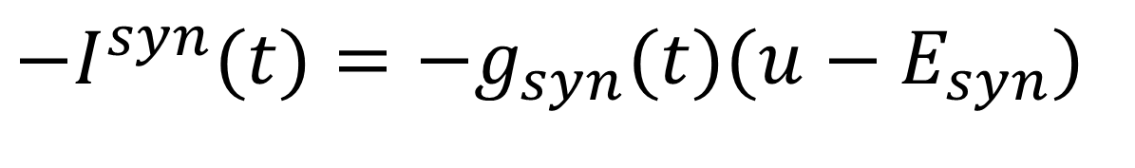
Neuronal Dynamics – 4.2. Synaptic reversal potential
glutamate: excitatory synapses
$$−I^{syn}(t)=−g_{syn}(t)(u−E_{syn})$$
$$E_{syn}≈0mV$$
GABA: inhibitory synapses
$$−I^{syn}(t)=−g_{syn}(t)(u−E_{syn})$$
$$E_{syn}≈−75mV$$

Slide 13
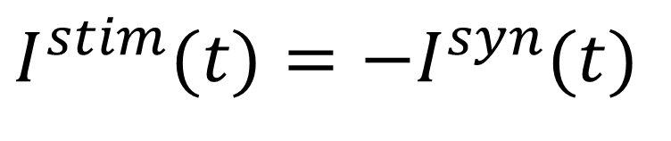
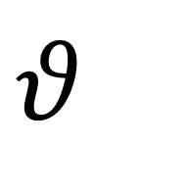
Neuronal Dynamics – 4.2. Synapses
glutamate: excitatory synapses
$$I^{stim}(t)=−I^{syn}(t)$$
$$−I^{syn}(t)=−g_{syn}(t)(u−E_{syn})$$
$$E_{syn}≈0mV$$
$$θ_{}$$
GABA: inhibitory synapses
$$−I^{syn}(t)=−g_{syn}(t)(u−E_{syn})$$
$$E_{syn}≈−75mV$$

Slide 14
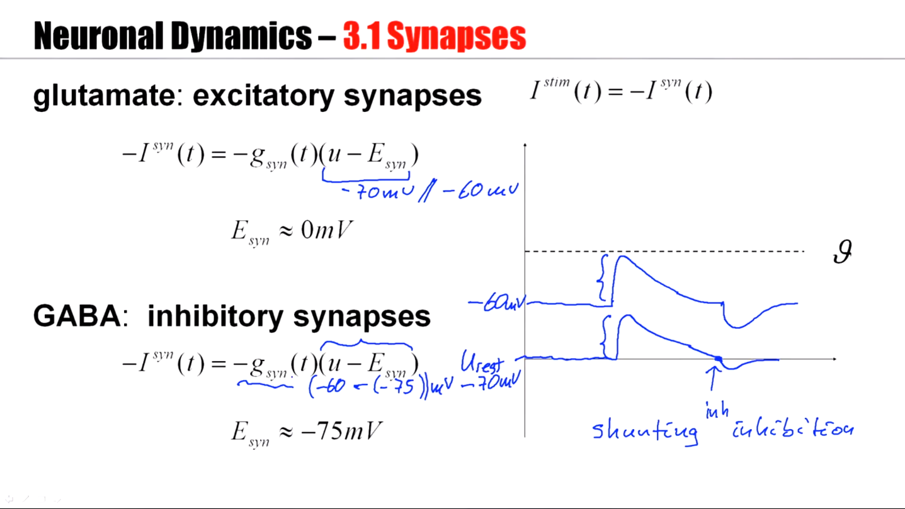
Notes:
突触的reverse potential不一样。
对于glutamate，u(静息)电压是70还是60，电流差别不大。
但是对于GABA，u(静息)电压是70还是60，差别到了3倍。甚至如果u = -75，电流等于0，此时叫做shunting inhibition。

Slide 15
Neuronal Dynamics – 4.2.Synapses
Synapse

Slide 16
Neuronal Dynamics – Quiz 4.3
Multiple answers possible!
AMPA channel
[ ] AMPA channels are activated by AMPA
[ ] If an AMPA channel is open, AMPA can pass through the channel
[ ] If an AMPA channel is open, glutamate can pass through the channel
[ ] If an AMPA channel is open, potassium can pass through the channel
[ ] The AMPA channel is a transmitter-gated ion channel
[ ] AMPA channels are often found in a synapse
Synapse types
[ ] In the subthreshold regime, excitatory synapses always depolarize the
membrane, i.e., shift the membrane potential to more positive values
[ ] In the subthreshold regime, inhibitory synapses always hyperpolarize the
membranel, i.e., shift the membrane potential more negative values
[ ] Excitatory synapses in cortex often contain AMPA receptors
[ ] Excitatory synapses in cortex often contain NMDA receptors

Slide 17
Neuronal Dynamics: Computational Neuroscience of Single Neurons
Week 3 – part 2: Synaptic short-term plasticity
3.1 Synapses
3.2 Short-term plasticity
3.3 Dendrite as a Cable
3.4 Cable equation
3.5 Compartmental Models
- active dendrites
Week 3 – Adding Detail:
Dendrites and Synapses
Wulfram Gerstner
EPFL, Lausanne, Switzerland

Slide 18
Week 3 – part 2: Synaptic Short-Term plasticity
3.1 Synapses
3.2 Short-term plasticity
3.3 Dendrite as a Cable
3.4 Cable equation
3.5 Compartmental Models
- active dendrites

Slide 19
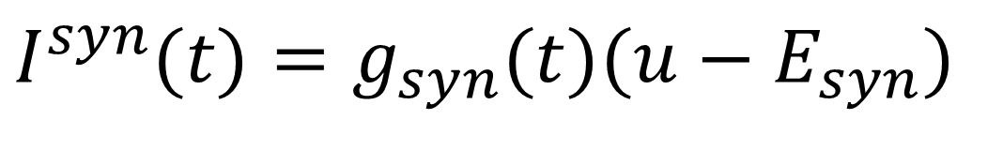
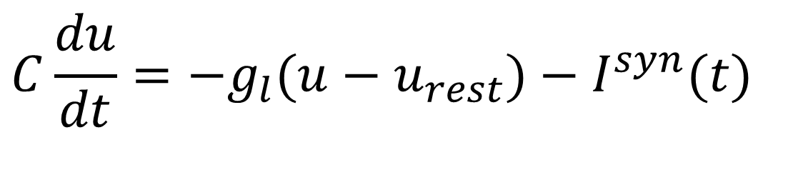
Neuronal Dynamics – 3.2 Synaptic Short-Term Plasticity
$$I^{syn}(t)=g_{syn}(t)(u−E_{syn})$$
$$C\frac{du}{dt}=−g_{l}(u−u_{rest})−I^{syn}(t)$$
pre
post
i
j
Notes:
Synapses can change their strength. Synapses are plastic.

Slide 20
Neuronal Dynamics – 3.2 Synaptic Short-Term Plasticity
Short-term plasticity/
fast synaptic dynamics
Thomson et al. 1993
Markram et al 1998
Tsodyks and Markram 1997
Abbott et al. 1997
pre
post
i
j

Slide 21
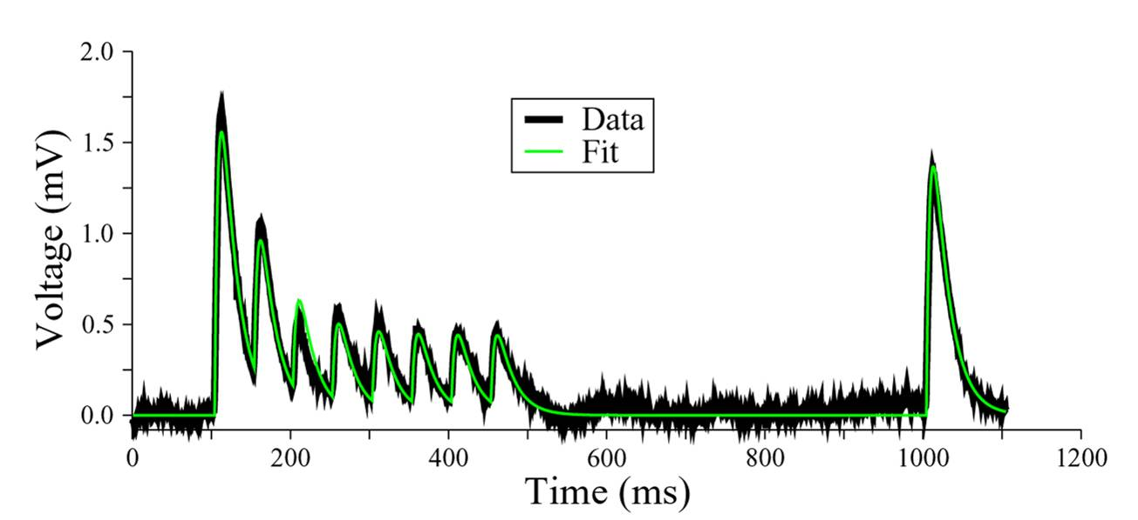

Neuronal Dynamics – 3.2 Synaptic Short-Term Plasticity
+50ms
20Hz
pre j
$$w_{ij}$$
post
i
Changes
- induced over 0.5 sec
- recover over 1 sec
Courtesy M.J.E Richardson
Data: G. Silberberg, H.Markram
Fit: M.J.E. Richardson (Tsodyks-Pawelzik-Markram model)

Slide 22
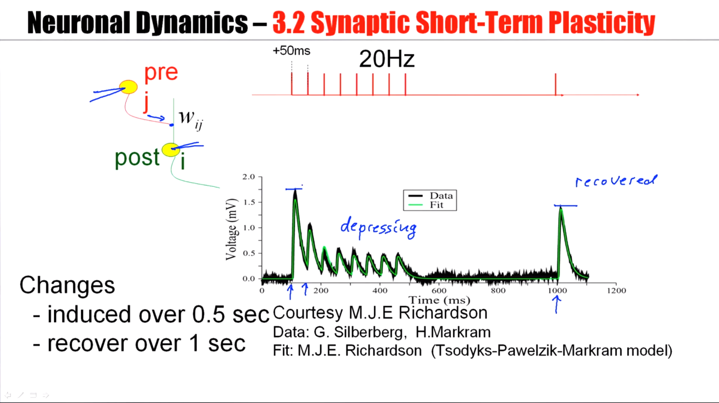

Slide 23
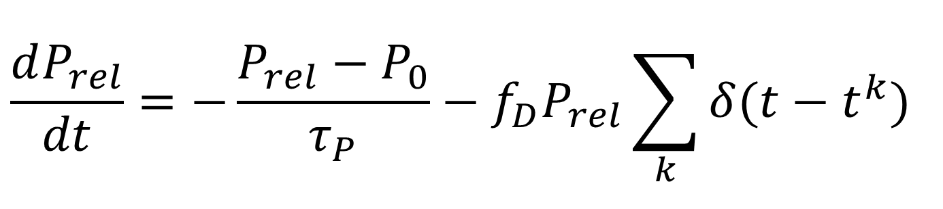
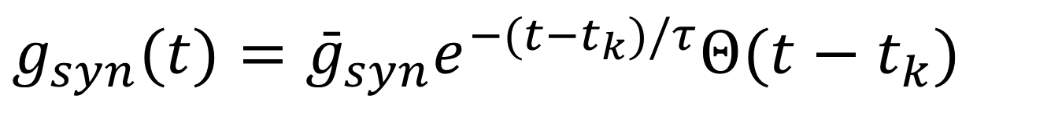
Neuronal Dynamics – 3.2 Model of Short-Term Plasticity
Dayan and Abbott,
2001
Fraction of filled release sites
$$\frac{dP_{rel}}{dt}=−\frac{P_{rel}−P_{0}}{τ_{P}}−f_{D}P_{rel}\sum_{k}{δ(t−t^{k})}$$
Synaptic conductance
$$g_{syn}(t)={\bar{g}}_{syn}e^{−(t−t_{k})/τ}Θ(t−t_{k})$$
image: Neuronal Dynamics,
Cambridge Univ. Press
Notes:
How could we model the observed effects of synaptic depression?

Slide 24
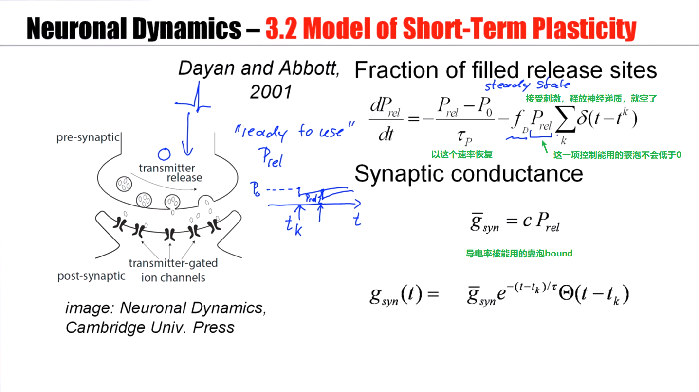
Notes:
并不是所有的囊都准备起作用，只有离膜进的才会准备释放，在中间部分的不发生作用。

Slide 25
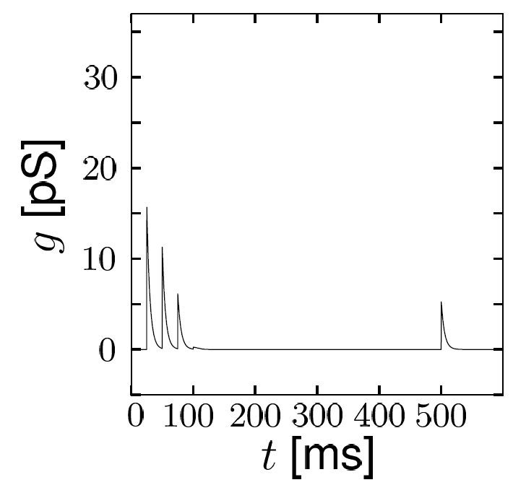
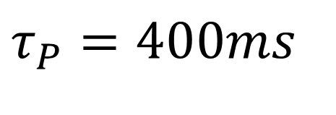
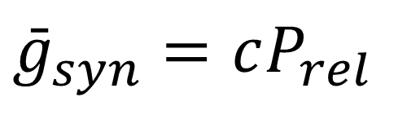
Neuronal Dynamics – 3.2 Model of synaptic depression
4 + 1 pulses
$$τ_{P}=400ms$$
Fraction of filled release sites
$$\frac{dP_{rel}}{dt}=−\frac{P_{rel}−P_{0}}{τ_{P}}−f_{D}P_{rel}\sum_{k}{δ(t−t^{k})}$$
Synaptic conductance
$${\bar{g}}_{syn}=cP_{rel}$$
$$g_{syn}(t)={\bar{g}}_{syn}e^{−(t−t_{k})/τ}Θ(t−t_{k})$$
image: Neuronal Dynamics,
Cambridge Univ. Press
Dayan and Abbott, 2001

Slide 26
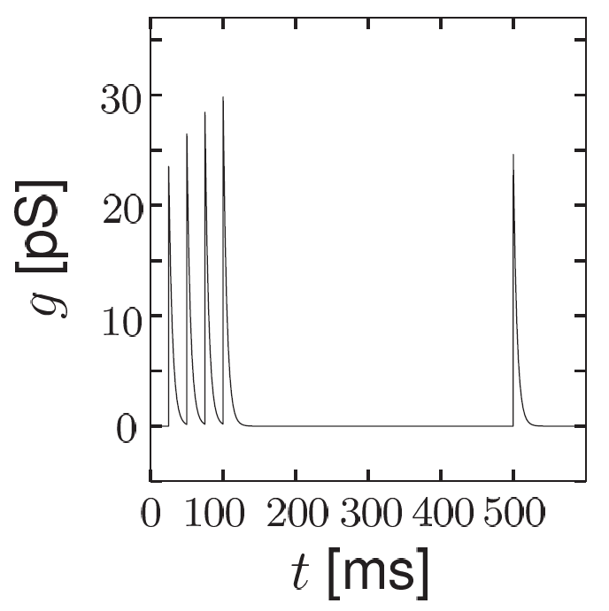
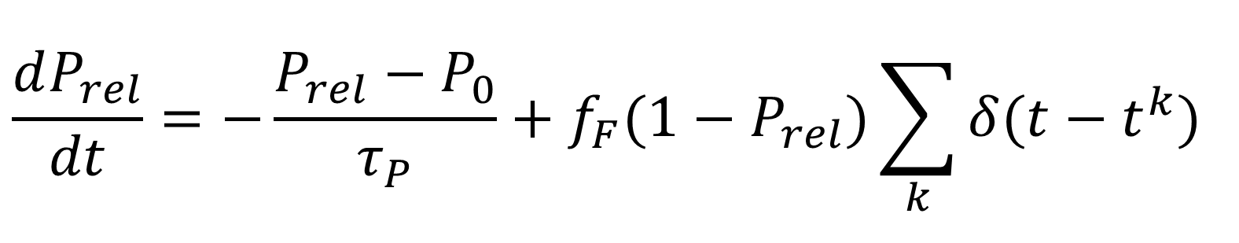
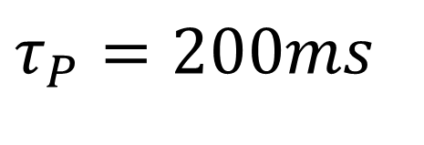
Neuronal Dynamics – 3.2 Model of synaptic facilitation
4 + 1 pulses
$$τ_{P}=200ms$$
Fraction of filled release sites
$$\frac{dP_{rel}}{dt}=−\frac{P_{rel}−P_{0}}{τ_{P}}+f_{F}(1−P_{rel})\sum_{k}{δ(t−t^{k})}$$
Synaptic conductance
$${\bar{g}}_{syn}=cP_{rel}$$
$$g_{syn}(t)={\bar{g}}_{syn}e^{−(t−t_{k})/τ}Θ(t−t_{k})$$
image: Neuronal Dynamics,
Cambridge Univ. Press
Dayan and Abbott, 2001
Notes:
这里P_rel在每次spike以后，都会加上不可用的中的一部分。

Slide 27
Neuronal Dynamics – 3.2 Summary
pre
post
j
i
Synapses are not constant
Depression
Facilitation
Models are available
Tsodyks-Pawelzik-Markram 1997
Dayan-Abbott 2001
Notes:
Synapses are not constant, they change all the time.

Slide 28
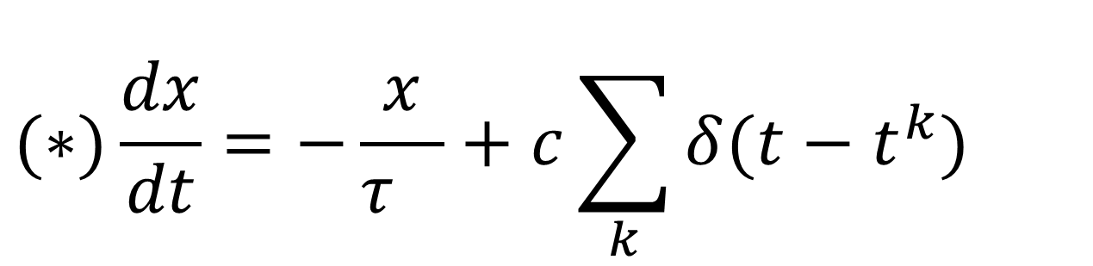
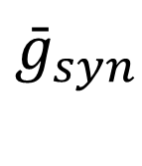
Neuronal Dynamics – Quiz 3.2
Multiple answers possible!
Time scales of Synaptic dynamics
[ ] The rise time of a synapse can be in the range of a few ms.
[ ] The decay time of a synapse can be in the range of few ms.
[ ] The decay time of a synapse can be in the range of few hundred ms.
[ ] The depression time of a synapse can be in the range of a few hundred ms.
[ ] The facilitation time of a synapse can be in the range of a few hundred ms.
Synaptic dynamics and membrane dynamics.
Consider the equation
With a suitable interpretation of the variable x and the constant c
[ ] Eq. (*) describes a passive membrane voltage u(t) driven by spike arrivals.
[ ] Eq. (*) describes the conductance g(t) of a simple synapse model.
[ ] Eq. (*) describes the maximum conductance of a facilitating synapse
$$(∗)\frac{dx}{dt}=−\frac{x}{τ_{}}+c\sum_{k}{δ(t−t^{k})}$$
$${\bar{g}}_{syn}$$

Slide 29
Neuronal Dynamics – 3.2 Literature/short-term plasticity
Dayan, P. and Abbott, L. F. (2001). Theoretical Neuroscience. MIT Press, Cambridge.
Abbott, L. F., Varela, J. A., Sen, K., and Nelson, S. B. (1997). Synaptic depression and cortical gain control. Science 275, 220–224.
Markram, H., and Tsodyks, M. (1996a). Redistribution of synaptic efficacy between neocortical pyramidal neurons. Nature 382, 807–810.
A.M. Thomson, Facilitation, augmentation and potentiation at central synapses,
Trends in Neurosciences, 23: 305–312 ,2001
Tsodyks, M., Pawelzik, K., and Markram, H. (1998). Neural networks with dynamic synapses. Neural. Comput. 10, 821–835.

Slide 30
Biological Modeling of Neural Networks
Week 4 – part 2: More Detail – compartmental models
3.1 From Hodgkin-Huxley to 2D
3.2 Phase Plane Analysis
3.3 Analysis of a 2D Neuron Model
4.1 Type I and II Neuron Models
- limit cycles
- where is the firing threshold?
- separation of time scales
4.2. Dendrites
- synapses
-cable equation
Week 4
– Reducing detail
- Adding detail
Wulfram Gerstner
EPFL, Lausanne, Switzerland

Slide 31
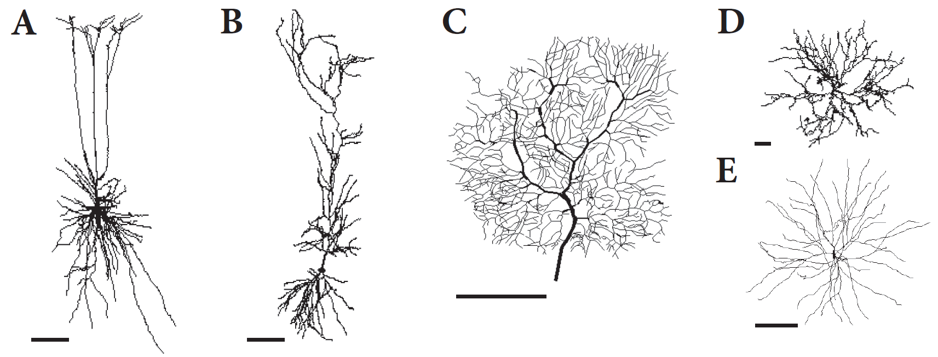
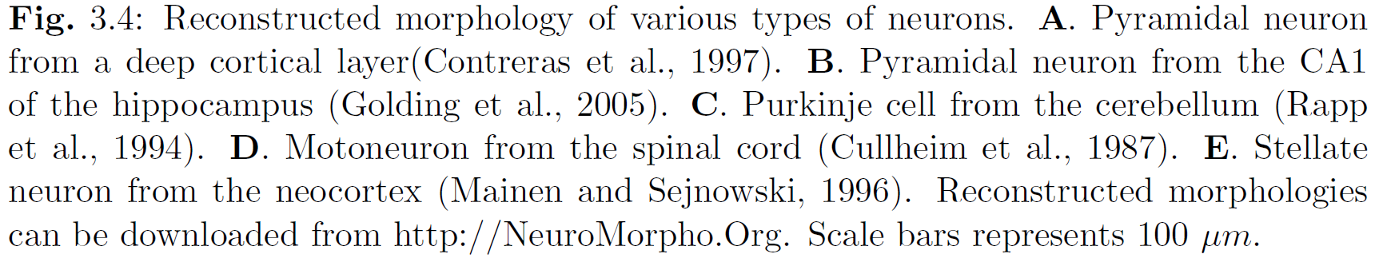
Neuronal Dynamics – 4.2 Dendrites

Slide 32
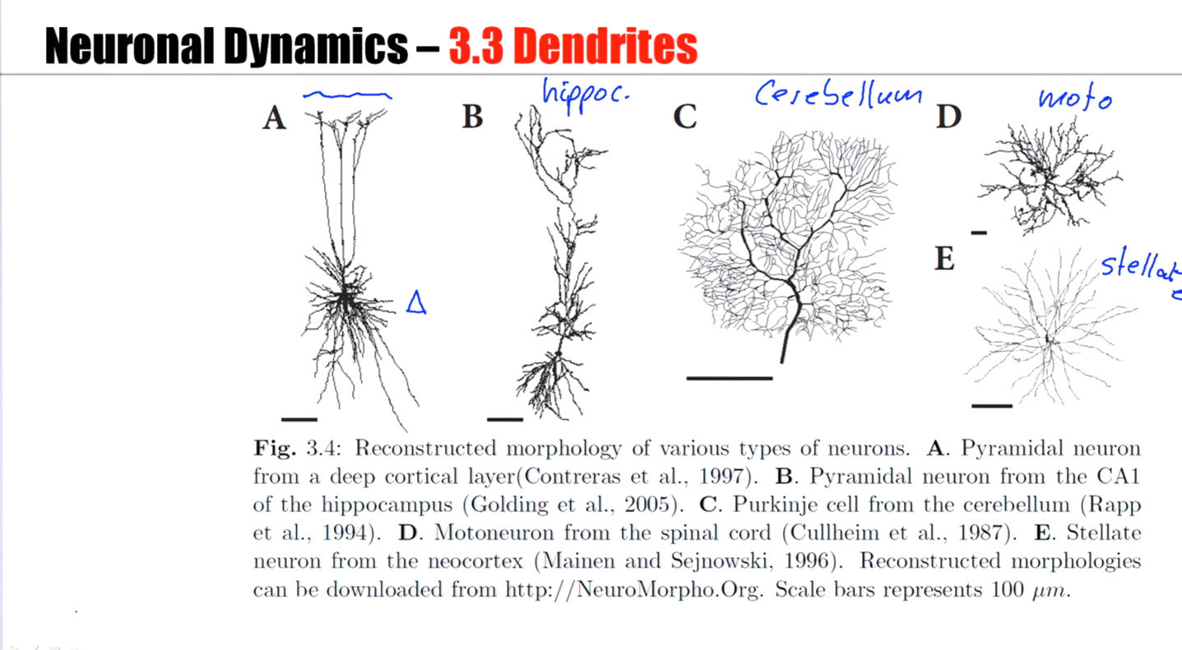

Slide 33
Neuronal Dynamics – Review: Biophysics of neurons
Cell surrounded by membrane
Membrane contains
- ion channels
- ion pumps
Dendrite and axon:
Cable-like extensions
Tree-like structure
-70mV
soma
Na⁺
action
potential
K⁺
Ca²⁺
Ions/proteins

Slide 34
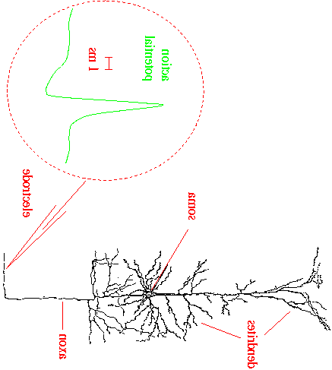
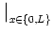
ndrites.
Neuronal Dynamics – Modeling the Dendrite
soma
Dendrite
Longitudinal
Resistance RL
I
I
C
g_{ion}
C
g_{l}
g_{l}

Slide 35
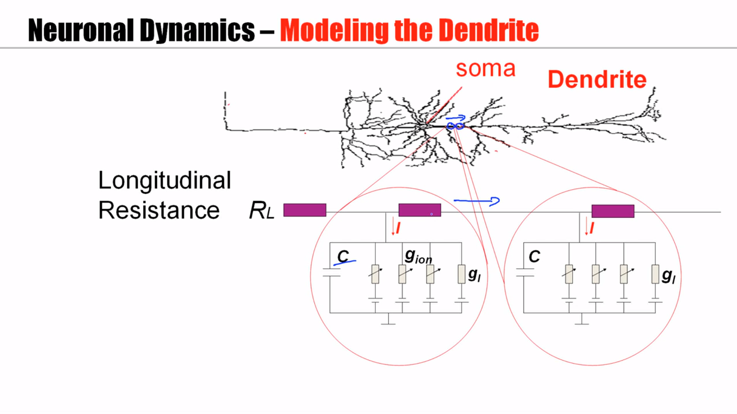

Slide 36
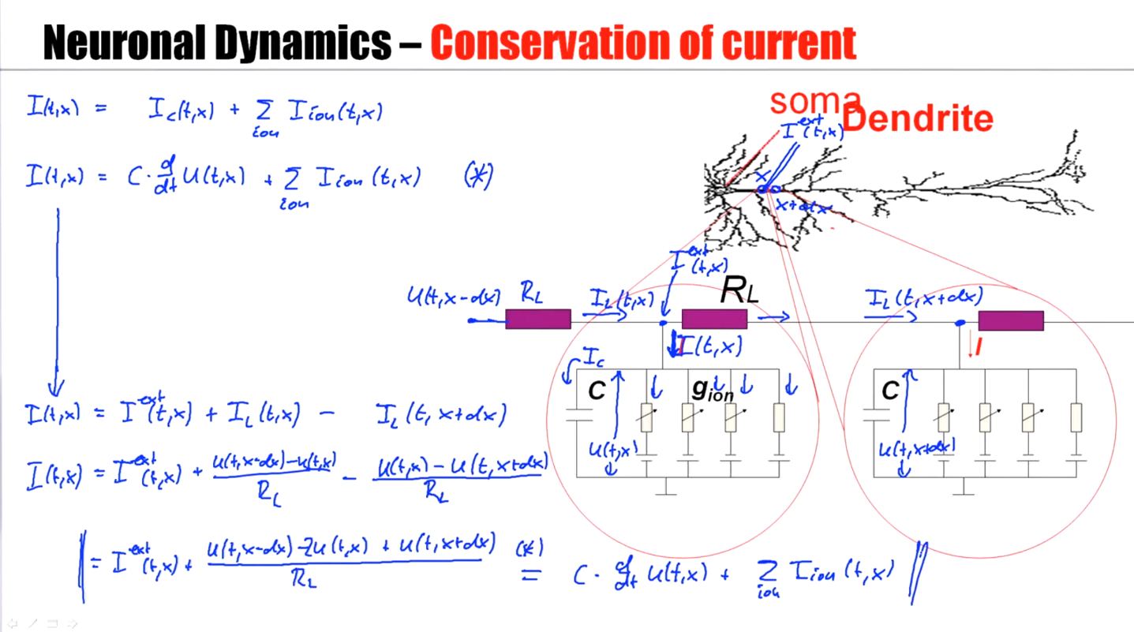
Notes:
The final equation describes the current flow along the dendrite, between different segments of the dendrite, and the current flow through the membrane into the outer extracellular space.

Slide 37
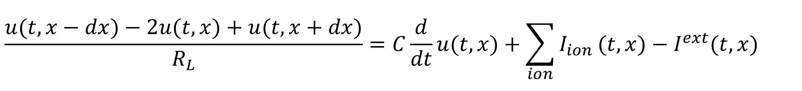
Neuronal Dynamics – 4.2 Equation-Coupled compartments
$$\frac{u(t,x−dx)−2u(t,x)+u(t,x+dx)}{R_{L}}=C\frac{d}{dt}u(t,x)+\sum_{ion}{I_{ion}}(t,x)−I^{ext}(t,x)$$
Basis for
Cable equation
-Compartmental models
I
I
C
g_{ion}
C
Notes:
The equation which we have just derived, is central for the description of electric current flow in dendrites.
It is the basis for the compartmental models that we will see in the last lecture of this week.
But it is also the basis for the cable equation. The derivation of the cable equation
is the topic of the next part. Please stay on! The lecture continues!

Slide 38
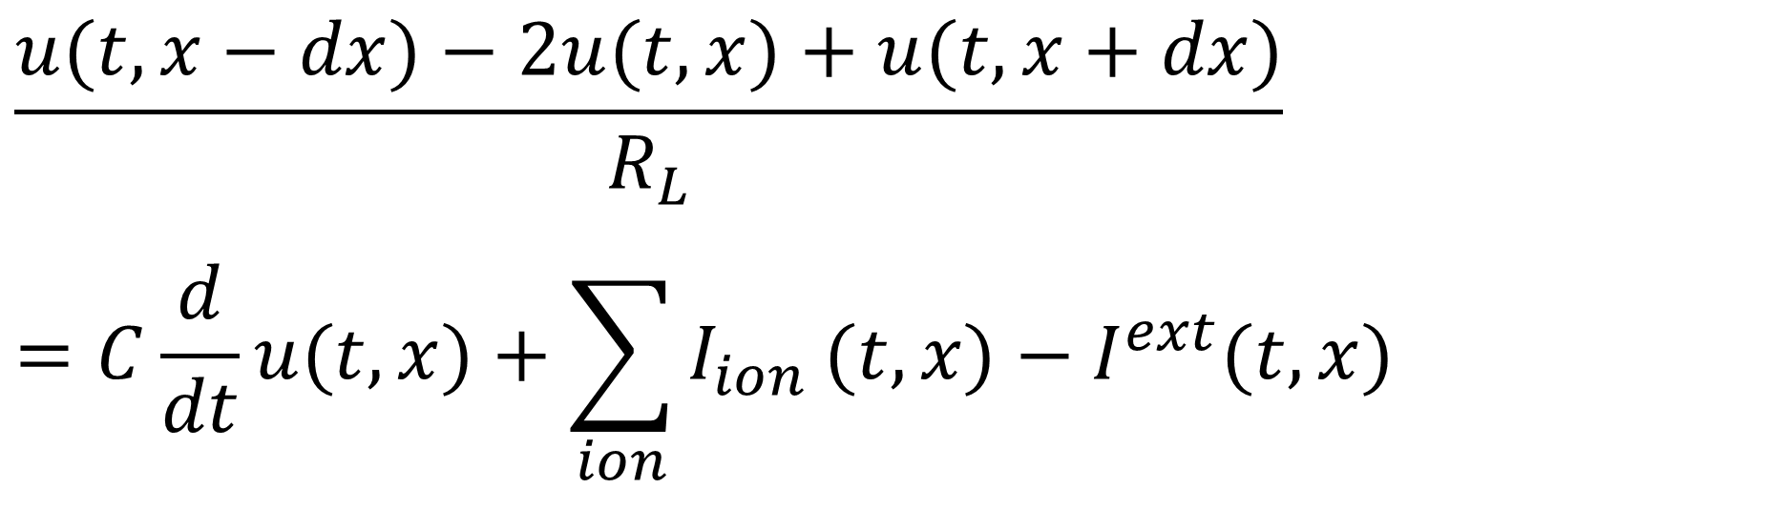
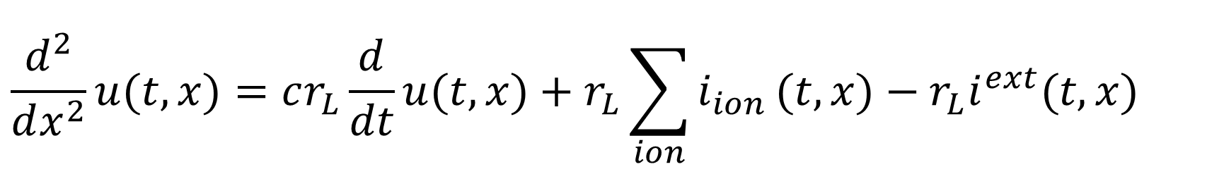
Neuronal Dynamics – 4.2 Derivation of Cable Equation
$$\frac{u(t,x−dx)−2u(t,x)+u(t,x+dx)}{R_{L}} \\ =C\frac{d}{dt}u(t,x)+\sum_{ion}{I_{ion}}(t,x)−I^{ext}(t,x)$$
I
I
C
g_{ion}
C
mathemetical derivation, now
$$\frac{d^{2}}{dx^{2}}u(t,x)=cr_{L}\frac{d}{dt}u(t,x)+r_{L}\sum_{ion}{i_{ion}}(t,x)−r_{L}i^{ext}(t,x)$$
Notes:
Welcome back to the continuation of Lecture 3. The discussion stopped with an equation
That describes the electrical properties of a small segment of a dendrite.
The definition of the segments involved some arbitrary choice of the segment size.
We would like now to get rid of this arbitrary choice. CLICK! To do so, we
take the continuum limit and derive the so-called cable equation shown at the bottom of this slide

Slide 39
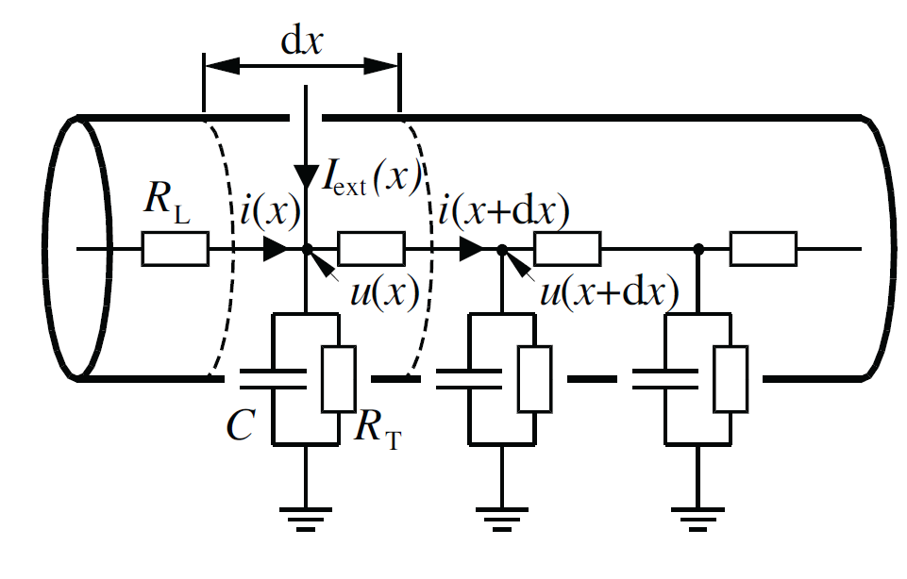
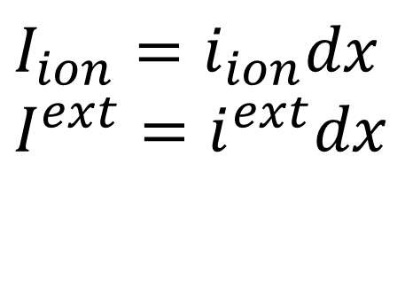
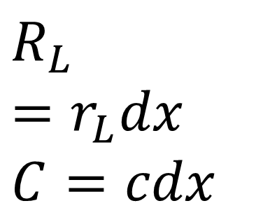
Neuronal Dynamics – 4.2 Modeling the Dendrite
$$R_{L}=r_{L}dx \\ C=cdx$$
gion
g
$$I_{ion}=i_{ion}dx \\ I^{ext}=i^{ext}dx$$

Slide 40
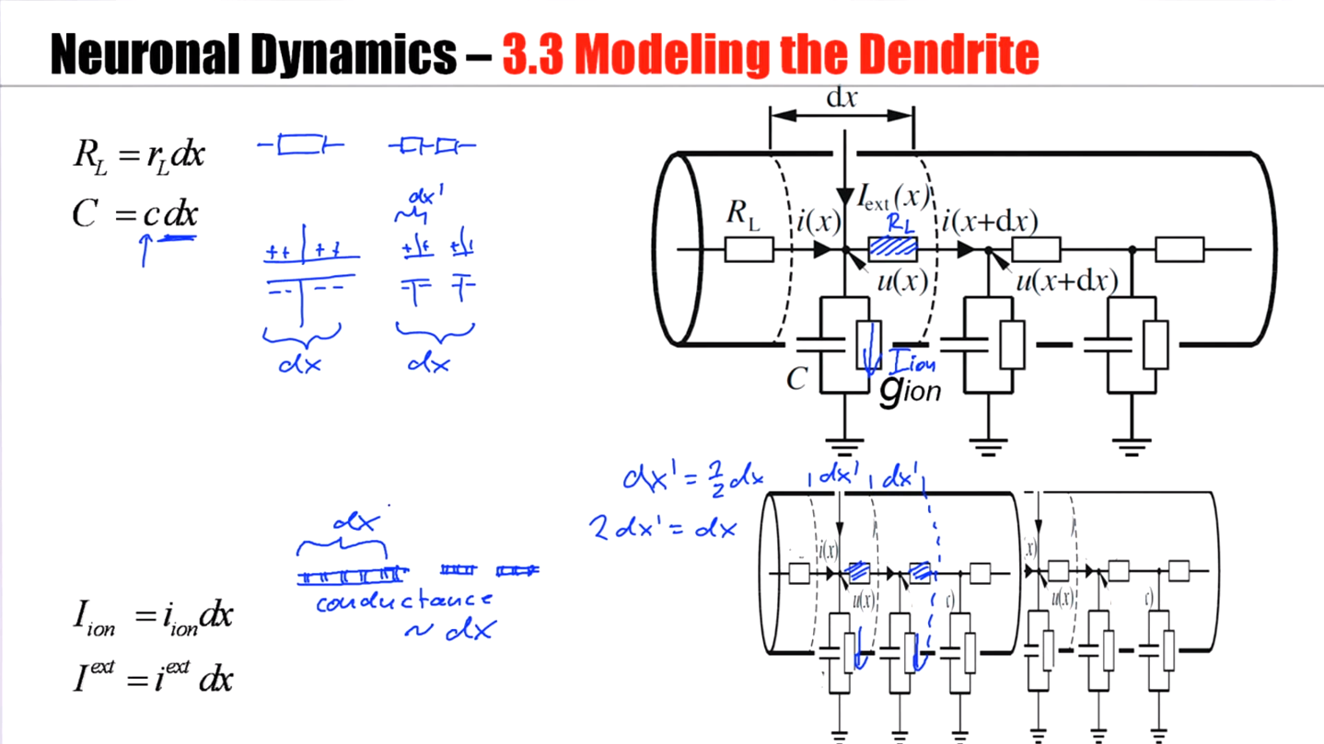
Notes:
R, C, I都根据dx成比例增大或者减小

Slide 41
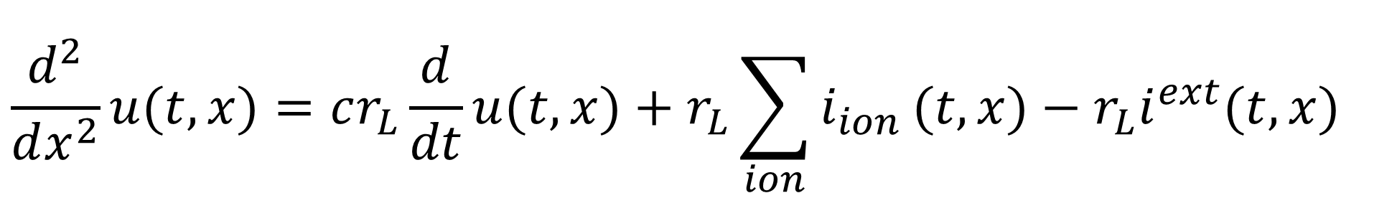
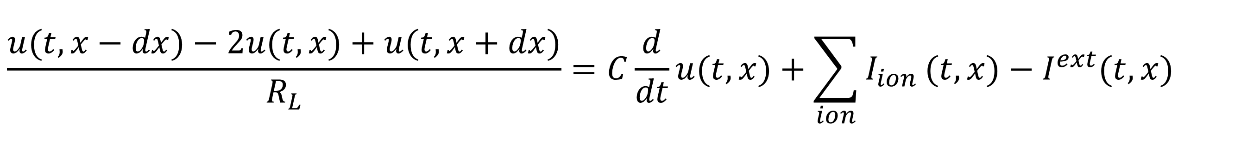


Neuronal Dynamics – 4.2 Derivation of cable equation
$$\frac{u(t,x−dx)−2u(t,x)+u(t,x+dx)}{R_{L}}=C\frac{d}{dt}u(t,x)+\sum_{ion}{I_{ion}}(t,x)−I^{ext}(t,x)$$
$$R_{L}=r_{L}dx \\ C=cdx$$
$$I_{ion}=i_{ion}dx \\ I^{ext}=i^{ext}dx$$
$$\frac{d^{2}}{dx^{2}}u(t,x)=cr_{L}\frac{d}{dt}u(t,x)+r_{L}\sum_{ion}{i_{ion}}(t,x)−r_{L}i^{ext}(t,x)$$

Slide 42

Notes:
Cable上电压差的变化的变化 = Cable上电压差的变化 + 离子通道的电流 + 外部电流

Slide 43




Neuronal Dynamics – 4.2 Dendrite as a cable
$$\frac{d^{2}}{dx^{2}}u(t,x)=cr_{L}\frac{d}{dt}u(t,x)+r_{L}\sum_{ion}{i_{ion}}(t,x)−r_{L}i^{ext}(t,x)$$
$$\sum_{ion}{i_{ion}}(t,x)=leak$$
passive dendrite
$$\sum_{ion}{i_{ion}}(t,x)=Ca,Na,...$$
active dendrite
$$\sum_{ion}{i_{ion}}(t,x)=Na,K,...$$
axon

Slide 44
Neuronal Dynamics – Quiz 4.4
Multiple answers possible!
Scaling of parameters.
Suppose the ionic currents through the membrane are well approximated by a simple leak current. For a dendritic segment of size dx, the leak current is through the membrane characterized by a membrane resistance R. If we change the size of the segment
From dx to 2dx
[ ] the resistance R needs to be changed from R to 2R.
[ ] the resistance R needs to be changed from R to R/2.
[ ] R does not change.
[ ] the membrane conductance increases by a factor of 2.

Slide 45
ndrites.
Neuronal Dynamics – 4.2. Cable equation
soma
Dendrite
RL
I
I
C
g_{ion}
C

Slide 46

Neuronal Dynamics – 4.2 Cable equation
$$\frac{d^{2}}{dx^{2}}u(t,x)=cr_{L}\frac{d}{dt}u(t,x)+r_{L}\sum_{ion}{i_{ion}}(t,x)−r_{L}i^{ext}(t,x)$$
$$\sum_{ion}{i_{ion}}(t,x)=leak$$
passive dendrite
$$\sum_{ion}{i_{ion}}(t,x)=Ca,Na,...$$
active dendrite
$$\sum_{ion}{i_{ion}}(t,x)=Na,K,...$$
axon
Notes:
A passive dendrite means that I only have an ohmic current, a current that corresponds to Ohm's law, a current that does not give rise to action potentials.

Slide 47





Neuronal Dynamics – 4.2 Derivation for passive cable
$$\frac{d^{2}}{dx^{2}}u(t,x)=cr_{L}\frac{d}{dt}u(t,x)+r_{L}\sum_{ion}{i_{ion}}(t,x)−r_{L}i^{ext}(t,x)$$
$$\sum_{ion}{i_{ion}}(t,x)=leak$$
passive dendrite
$$I_{ion}=i_{ion}dx \\ I^{ext}=i^{ext}dx$$
See exercise 3
$$\sum_{ion}{i_{ion}}(t,x)=\frac{u}{r_{m}}$$
$$λ^{2}\frac{d^{2}}{dx^{2}}u(t,x)=τ_{m}\frac{d}{dt}u(t,x)+u−r_{m}i^{ext}(t,x)$$

Slide 48

Notes:
R_{L}: Longitudinal resistance
R_{M}: Membrane resistance

Slide 49


ndrites.
Neuronal Dynamics – 4.2 dendritic stimulation
soma
passive dendrite/passive cable
$$λ^{2}\frac{d^{2}}{dx^{2}}u(t,x)=τ_{m}\frac{d}{dt}u(t,x)+u−r_{m}i^{ext}(t,x)$$
Stimulate dendrite, measure at soma

Slide 50

Notes:
If you stimulate further out in the cable, then the total effect at the soma is much less.
If you stimulate close to the soma, then there's an initial sharp rise and a sharp peak measured at the soma.

Slide 51
ndrites.
Neuronal Dynamics – 4.2 dendritic stimulation
soma
The END

Slide 52




Neuronal Dynamics – Quiz 4.5
Multiple answers possible!
The space constant of a
passive cable is
[ ]
[ ]
[ ]
[ ]
Dendritic current injection.
If a short current pulse is injected into the dendrite
[ ] the voltage at the injection site is maximal immediately after the end of the injection
[ ] the voltage at the dendritic injection site is maximal a few milliseconds after the end of the injection
[ ] the voltage at the soma is maximal immediately after the end of the injection.
[ ] the voltage at the soma is maximal a few milliseconds after the end of the injection
$$λ^{}=\frac{r_{m}}{r_{L}}$$
$$λ^{}=\frac{r_{L}}{r_{m}}$$
$$λ^{}=\sqrt{\frac{r_{L}}{r_{m}}}$$
It follows from the cable equation that
[ ] the shape of an EPSP depends on the dendritic location of the synapse.
[ ] the shape of an EPSP depends only on the synaptic time constant, but not on dendritic location.
$$λ^{}=\sqrt{\frac{r_{m}}{r_{L}}}$$

Slide 53








Neuronal Dynamics – Homework
Consider
(*)
(i) Take the second derivative of (*) with respect to x. The result is
(ii) Take the derivative of (*) with respect to t. The result is
(iii) Therefore the equation is a solution to
with
(iv) The input current is [ ]
[ ]
$$u(t,x)^{}=\frac{1}{\sqrt{4πt}}\exp{[}−t−\frac{(x−x_{0})^{2}}{4t}]fort>0$$
$$u(t,x)^{}=0fort<0$$
$$\frac{d^{2}}{dx^{2}}u(t,x)=..........$$
$$\frac{d}{dt}u(t,x)=....$$
$$λ^{2}\frac{d^{2}}{dx^{2}}u(t,x)=τ_{m}\frac{d}{dt}u(t,x)+u−r_{m}i^{ext}(t,x)$$
$$τ_{m}=....andλ=...$$
$$i^{ext}(t,x)=δ(t)δ(x−x_{0})$$
$$i^{ext}(t,x)=i_{0}fort>0$$

Slide 54



Neuronal Dynamics – Homework
Consider the two equations
(1)
(2)
The two equations are equivalent under the transform
with constants c= ….. and a = …..
$$λ^{2}\frac{d^{2}}{dx^{2}}u(t,x)=τ_{m}\frac{d}{dt}u(t,x)+u−r_{m}i^{ext}(t,x)$$
$$\frac{d^{2}}{d{\tilde{x}}^{2}}u(t′,\tilde{x})=\frac{d}{dt′}u(t′,\tilde{x})+u−i^{ext}(t′,\tilde{x})$$
$$\tilde{x}=cxandt′=at$$

Slide 55
ndrites.
Neuronal Dynamics – 4.3. Compartmental models
soma
dendrite
RL
I
I
C
g_{ion}
C

Slide 56


ndrites.
Neuronal Dynamics – 4.3. Compartmental models
$$\frac{u(t,μ−1)−u(t,μ)}{0.5(R_{L}^{μ}+R_{L}^{μ−1})}−\frac{u(t,μ)−u(t,μ+1)}{0.5(R_{L}^{μ}+R_{L}^{μ+1})}=C^{μ}\frac{d}{dt}u(t,μ)+\sum_{ion}{I_{ion}}(t,μ)−I^{μ}(t)$$
Software tools: - NEURON (Carnevale&Hines, 2006)
- GENESIS (Bower&Beeman, 1995)

Slide 57





ndrites.
Neuronal Dynamics – 4.3. Model of Hay et al. (2011)
Morphological reconstruction
Branching points
200 compartments
-spatial distribution of ion currents
Sodium current (2 types)
- HH-type (inactivating)
- persistent (non-inactivating)
Calcium current (2 types and calcium pump)
Potassium currents (3 types, includes )
Unspecific current
$$(≤20μm)$$
‘hotspot’
Ca currents
layer 5 pyramidal cell
$$I_{Na,transient}$$
$$I_{NaP}$$
$$I_{M}$$
Notes:
不同segment的构造不一定一样
The spatial distribution of these different ion channel types is not uniform across the dendrite, but some of the ion channels,
In particular, the calcium channels, have a higher density at some singular spots that are called the hot spots of the model.

Slide 58



Neuronal Dynamics – 4.3. Active dendrites: Model
Hay et al. 2011,
PLOS Comput. Biol.

Slide 59

Notes:
Because of this voltage deflection at location 2, there is a slight bump later on again at location 1.
The dendritic calcium spike will influence the voltage at the soma so that there another two action potentials are generated.

Slide 60

Neuronal Dynamics – 4.3. Active dendrites: Model
Hay et al. 2011,
PLOS Comput. Biol.
Notes:
The dendritic calcium spike does not need stimulation at soma. You can also just give a stronger current pulse at this dendritic location.

Slide 61

Neuronal Dynamics – 4.3. Active dendrites: Experiments
BPAP:
backpropagating action potential
Dendritic Ca spike:
activation of Ca channels
Ping-Pong:
BPAP and Ca spike
Larkum, Zhu, Sakman
Nature 1999
Notes:
Use pen to show direction of BPAP and Ca spike

Slide 62


Slide 63
Neuronal Dynamics – 4.3. Compartmental models
Dendrites are more than passive filters.
Hotspots
BPAPs
Ca spikes
Compartmental models
- can include many ion channels
- spatially distributed
- morphologically reconstructed
BUT
- spatial distribution of ion channels
difficult to tune
Notes:
In summary, dendrites are not just passive. They have active properties. They have calcium currents that can generate calcium spikes that are visible as large voltage transients.
Active dendrites permit back-propagating action potentials so that if an action potential is generated at a soma, the information about the action potential is available all over the dendrite.
Compartmental models can model all these different aspects of active dendrites. However, compartmental models are difficult to tune because you often don't know where along the dendrite, where to put the different ion channels at each density.

Slide 64
Neuronal Dynamics – Quiz 4.5
Multiple answers possible!
BPAP
[ ] is an acronym for BackPropagatingActionPotential
[ ] exists in a passive dendrite
[ ] travels from the dendritic hotspot to the soma
[ ] travels from the soma along the dendrite
[ ] has the same duration as the somatic action potential
Dendritic Calcium spikes
[ ] can be induced by weak dendritic stimulation
[ ] can be induced by strong dendritic stimulation
[ ] can be induced by weak dendritic stimulation combined with a BPAP
[ ] can only be induced be strong dendritic stimulation combined with a BPAP
[ ] travels from the dendritic hotspot to the soma
[ ] travels from the soma along the dendrite

Slide 65
Neuronal Dynamics – week 4 – Reading
Reading: W. Gerstner, W.M. Kistler, R. Naud and L. Paninski,
Neuronal Dynamics: from single neurons to networks and
models of cognition. Chapter 3: Dendrites and Synapses, Cambridge Univ. Press, 2014
OR W. Gerstner and W. M. Kistler, Spiking Neuron Models, Chapter 2, Cambridge, 2002
OR P. Dayan and L. Abbott, Theoretical Neuroscience, Chapter 6, MIT Press 2001
References:
M. Larkum, J.J. Zhu, B. Sakmann (1999), A new cellular mechanism for coupling inputs arriving at different cortical layers, Nature, 398:338-341
E. Hay et al. (2011) Models of Neocortical Layer 5b Pyramidal Cells Capturing a Wide Range of Dendritic and Perisomatic Active Properties, PLOS Comput. Biol. 7:7
Carnevale, N. and Hines, M. (2006). The Neuron Book. Cambridge University Press.
Bower, J. M. and Beeman, D. (1995). The book of Genesis. Springer, New York.
Rall, W. (1989). Cable theory for dendritic neurons. In Koch, C. and Segev, I., editors, Methods in
Neuronal Modeling, pages 9{62, Cambridge. MIT Press.
Abbott, L. F., Varela, J. A., Sen, K., and Nelson, S. B. (1997). Synaptic depression and cortical gain control. Science 275, 220–224.
Tsodyks, M., Pawelzik, K., and Markram, H. (1998). Neural networks with dynamic synapses. Neural. Comput. 10, 821–835.

